Slide 1
Arithmetic for Computers
Computer Architecture
Lecture 7

Slide 2

Addition and Subtraction
Let’s try adding 6_{ten} to 7_{ten} in binary and then subtracting 6_{ten} from 7_{ten} in binary.

Slide 3
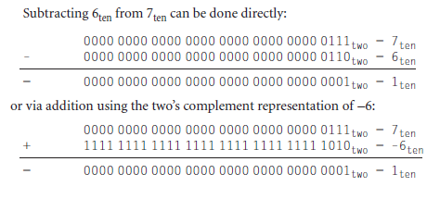
Addition and Subtraction

Slide 4
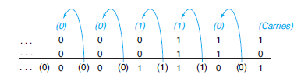
Binary addition, showing carries from right to left

Slide 5
Overflow during addition
Overflow occurs when the result from an operation cannot be represented with the available hardware, in this case a 32-bit word.
When adding operands with different signs, overflow cannot occur. The reason is the sum must be no larger than one of the operands.
For example, -10 + 4 = -6. Since the operands fit in 32 bits and the sum is no larger than an operand, the sum must fit in 32 bits as well. Therefore, no overflow can occur when adding positive and negative operands.

Slide 6
When does overflow occur in addition ?
Clearly, adding or subtracting two 32-bit numbers can yield a result that needs 33 bits to be fully expressed.
The lack of a 33rd bit means that when overflow occurs, the sign bit is set with the value of the result instead of the proper sign of the result.
Since we need just one extra bit, only the sign bit can be wrong.
Hence, overflow occurs when adding two positive numbers and the sum is negative, or vice versa. This means a carry out occurred into the sign bit.

Slide 7
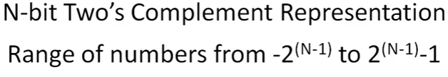
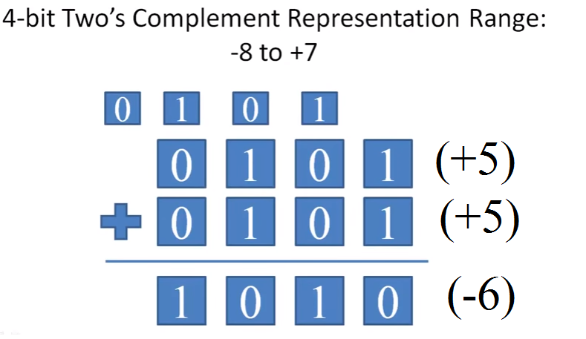
Example

Slide 8
Overflow during Subtraction
There are similar restrictions to the occurrence of overflow during subtract, but it’s just the opposite principle: when the signs of the operands are the same, overflow cannot occur.
To see this, remember that x - y = x + (-y) because we subtract by negating the second operand and then add.
Therefore, when we subtract operands of the same sign we end up by adding operands of different signs. We know that overflow cannot occur in this case either.

Slide 9
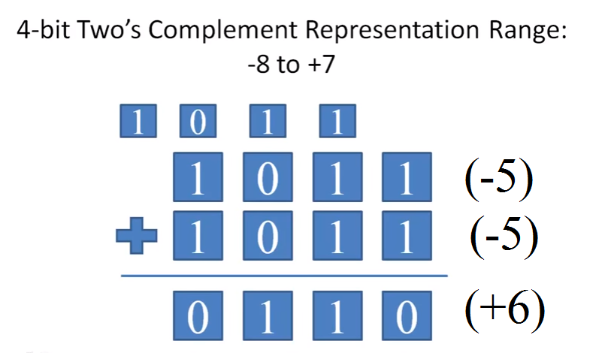
Example

Slide 10
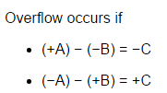
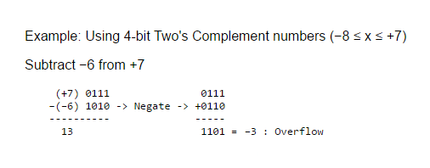
When does overflow occur in Subtraction ?
Overflow occurs in subtraction when we subtract a negative number from a positive number and get a negative result, or when we subtract a positive number from a negative number and get a positive result.
Example

Slide 11
Overflow
The computer designer must provide a way to ignore overflow in some cases (Memory Addresses) and to recognize it in others. The MIPS solution is to have two kinds of arithmetic instructions to recognize the two choices:
Add (add), add immediate (addi), and subtract (sub) cause exceptions on overflow.
Add unsigned (addu), add immediate unsigned (addiu), and subtract unsigned (subu) do not cause exceptions on overflow.

Slide 12
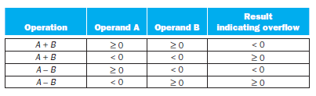
Overflow Conditions for addition and subtraction

Slide 13
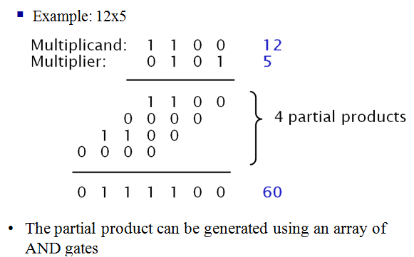
Multiplication

Slide 14
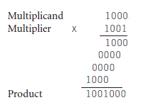
Multiplication
Two rules:
Place a copy of multiplicand in the proper place if multiplier bit=1.
Place 0 in the proper place if multiplier bit = 0.
The first operand is called the multiplicand and the second the multiplier. The final result is called the product.

Slide 15
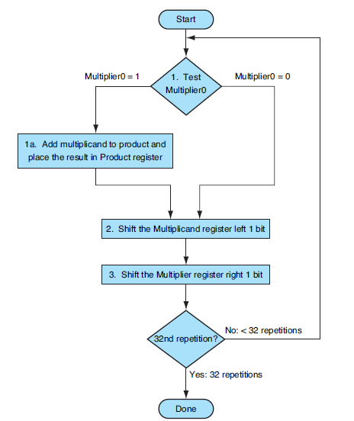
Sequential Multiplication Algorithm1

Slide 16
Sequential Multiplication Algorithm
Figure previous slide shows the three basic steps needed for each bit. The least significant bit of the multiplier (Multiplier0) determines whether the multiplicand is added to the Product register.
The left shift in step 2 has the effect of moving the intermediate operands to the left, just as when multiplying with paper and pencil.
The shift right in step 3 gives us the next bit of the multiplier to examine in the following iteration.
These three steps are repeated 32 times to obtain the product. If each step took a clock cycle, this algorithm would require almost 100 clock cycles to multiply

Slide 17
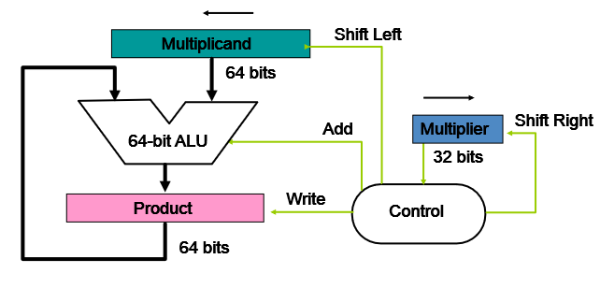
Sequential Multiplication Hardware

Slide 18
Sequential Multiplication Hardware
The Multiplicand register, ALU, and Product register are all 64 bits wide, with only the Multiplier register containing 32 bits.
The 32-bit multiplicand starts in the right half of the Multiplicand register and is shifted left 1 bit on each step.
The multiplier is shifted in the opposite direction at each step.
The algorithm starts with the product initialized to 0. Control decides when to shift the Multiplicand and Multiplier registers and when to write new values into the Product register.

Slide 19
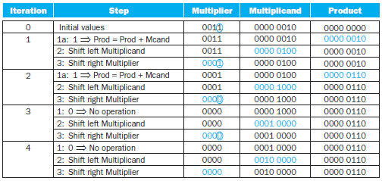
Example
Multiply 2_{ten} × 3_{ten}, or 0010_{two} × 0011_{two}.

Slide 20
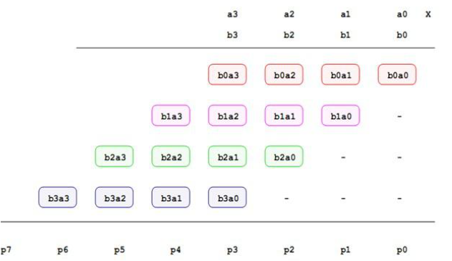
Improving the speed with Combinational Array Multiplier

Slide 21
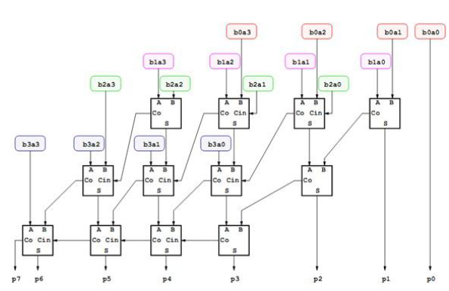
Combinational Array Multiplier

Slide 22
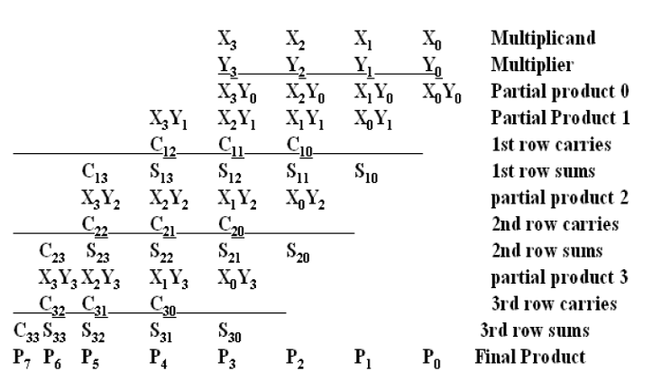
4-bit Multiplier Partial Products

Slide 23
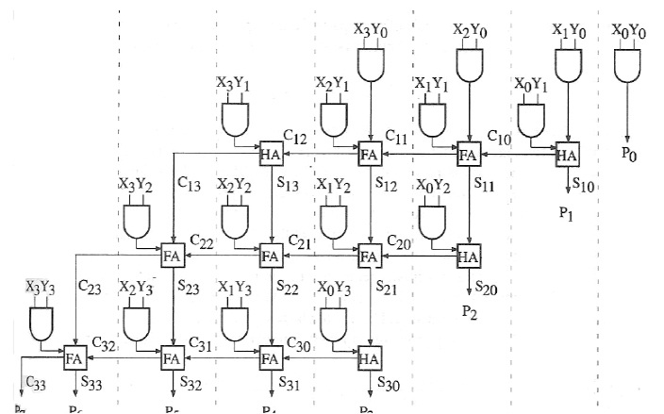
Block Diagram of 4×4 Array Multiplier

